Slide 1

Image Processing Tool: Version 2.0
The A Team
Sanan Aamir, Romando Garcia,
Anne Lam, James Rowe, Hieu Tran
Final Presentation
May 6, 2015

Slide 2
Outline
Introduction
Problem Description
System Architecture/Design Diagrams
Demo
Test Report
Deployment Issues
Deviations
Conclusion

Slide 3
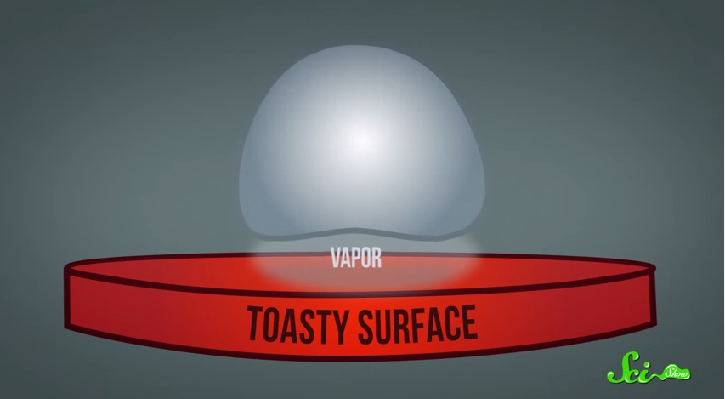
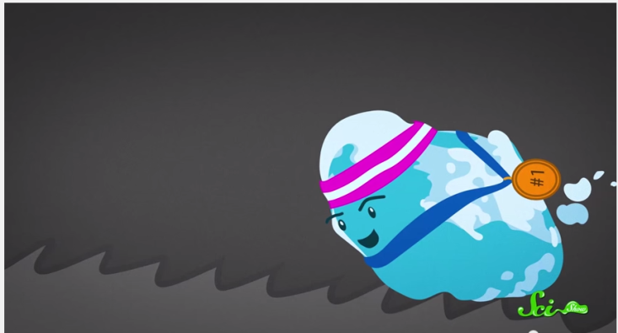
Introduction
The Leidenfrost Effect
Heating a liquid droplet above its boiling point creates a vapor pillow of its own gases underneath it
Slight disturbances move the droplet
Ratchet surface gives just the right disturbance to control the movement
Potential uses in micro-cooling
Notes:
Description of problem / user's work context -25%
Plan -10%
Process Model -5%
Team Organization -5%
Interface Design and System Design -25%
System to date/ What still is left -5%
Organization of presentation -10%
Creativity -15%

Slide 4
Description of Problem
Process droplet image
Kinematics & volume
Calibration
Pixel to real units
Display results in Excel
Visual data rep.
Automation & performance

Slide 5
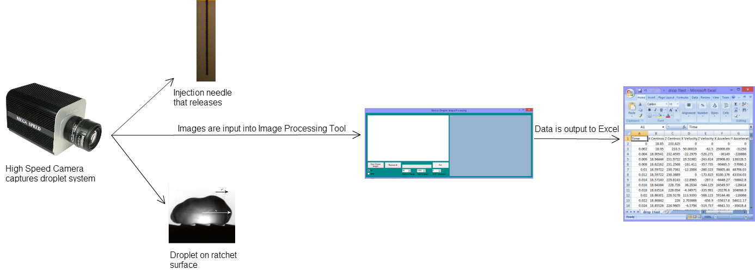
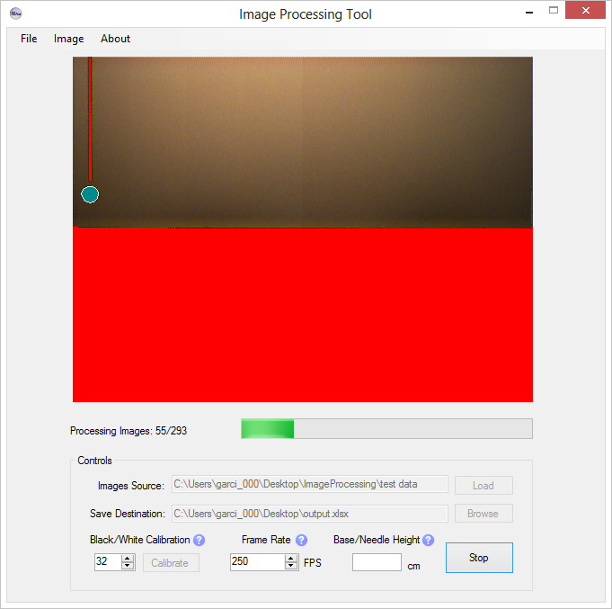
System Architecture
droplet

Slide 6
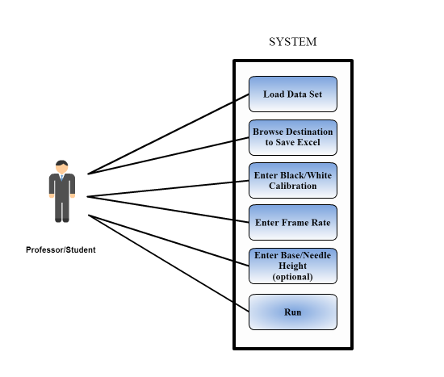
UML Use Case Diagram

Slide 7
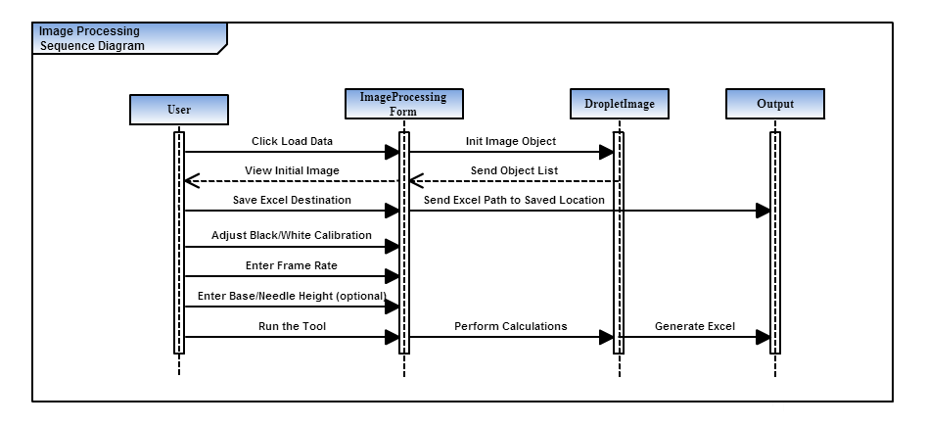
UML Sequence Diagram

Slide 8
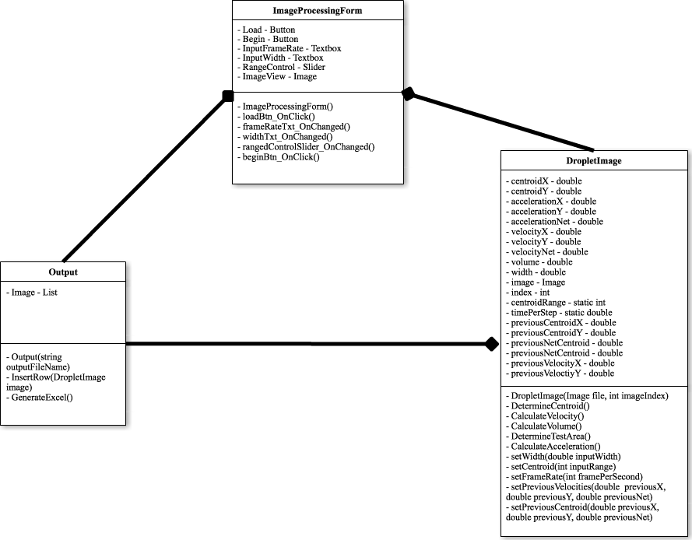
UML Class Diagram

Slide 9
Interface Design
Load Images
Name Output File
Calibrate Processed Image
Run data set
Enter frames per second
Enter distance between base/needle if known
Notes:
Then actually demo – use data set that required sensitive calibration.

Slide 10
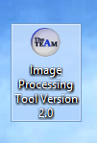
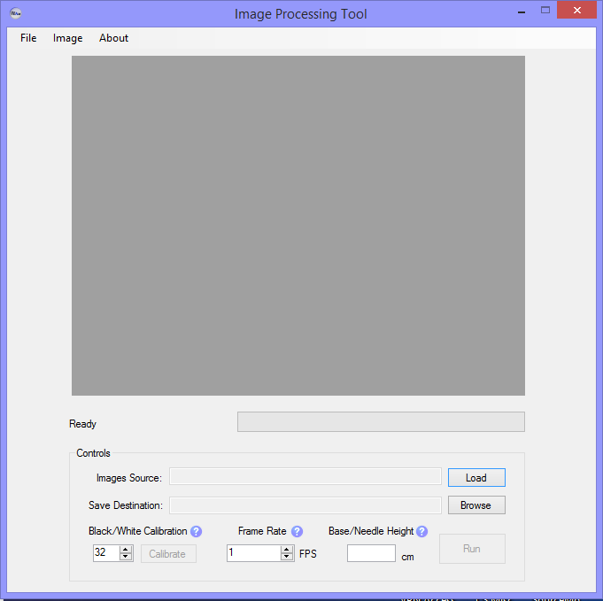
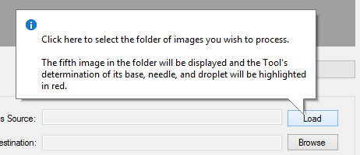
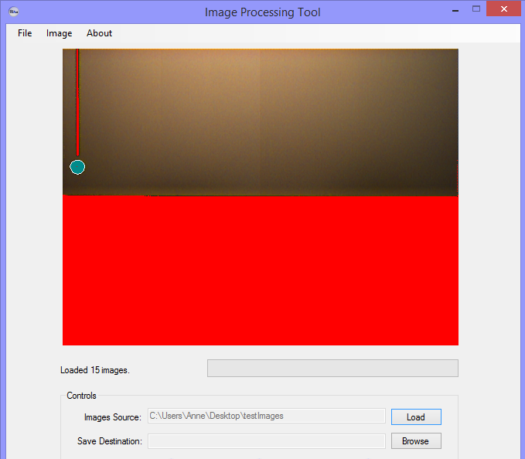
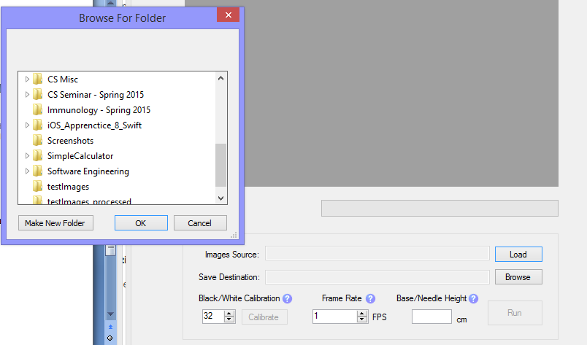
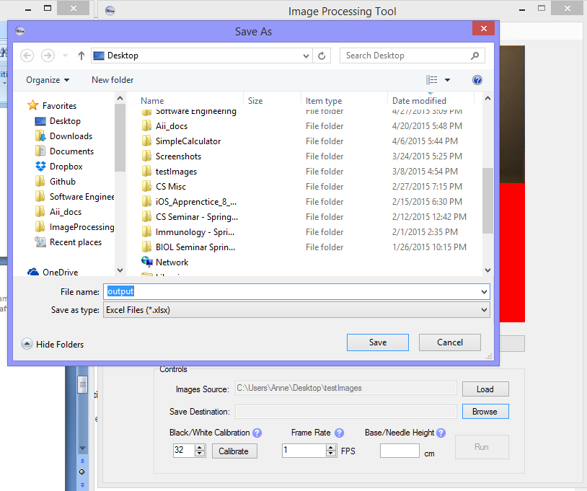
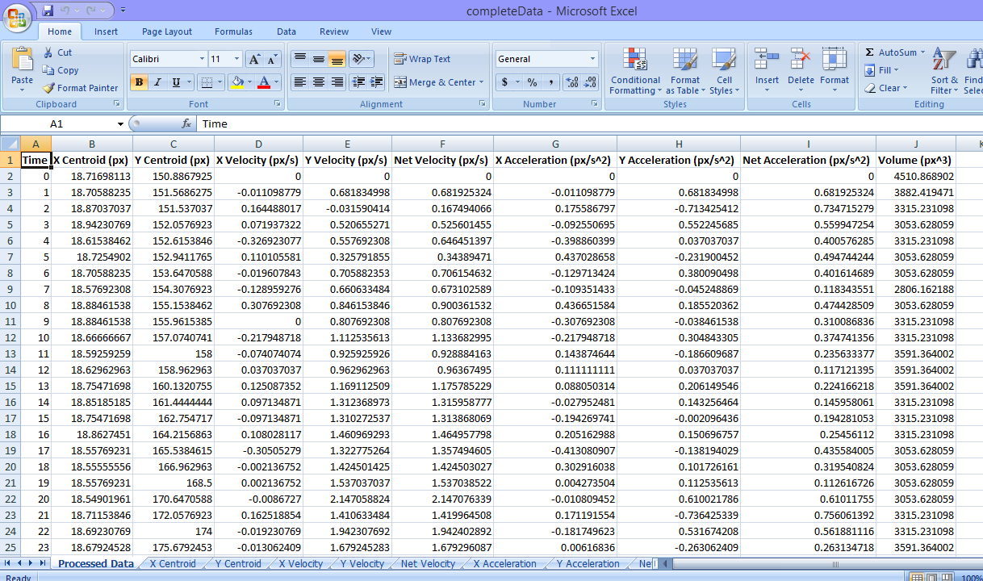
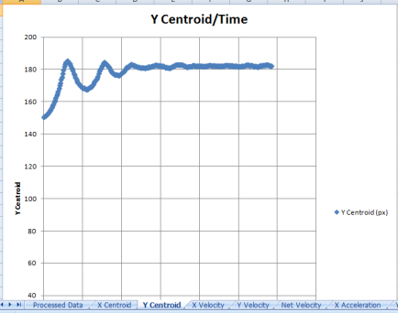
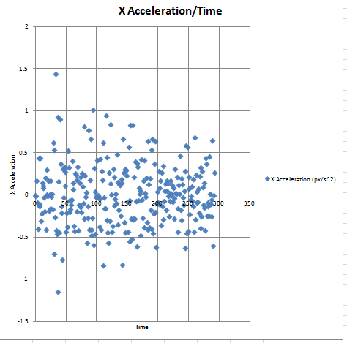
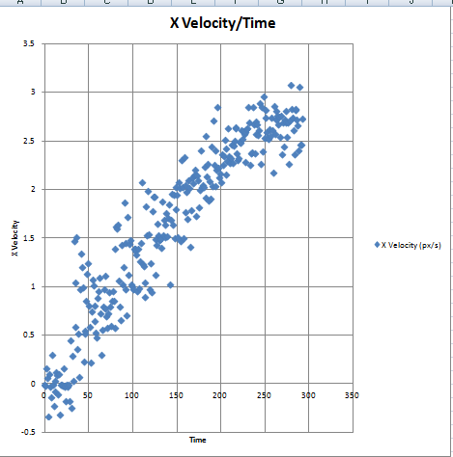
Demonstration
Notes:
Then actually demo – use data set that required sensitive calibration.

Slide 11

Proof in the Results

Slide 12

Test Report – Satisfied Requirements
Tracks the location of drop by following centroid
Determines location of needle/base automatically – able to fine tune
Does not require base image
Obtains volume and all required kinematics
Outputs to Excel
Generates plots as a function of time
Is Repeatable –successful for 3+ experimental sequences

Slide 13
Test Report – Satisfied Requirements Cont’d
Removes white center in drop
Provides accurate calculations

Slide 14


Test Report – Known problems
Run – Stop – Run again sequence may interrupt thread processes – cause crash
Similar issue with Exiting Tool during IO
Base/Needle height may not be measured accurately, will affect results

Slide 15
Deployment Issues
Source of bugs difficult to pinpoint
UI changed fairly often
Implementation phase longer than expected

Slide 16
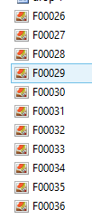

Deviations – Unsatisfied Requirements
Efficiency may not be improved
Processing time up to 2.5x longer vs Version 1.0
From ~1 min to ~2 min
But more robust, accurate
Microsoft Excel is required & table lacks the “frame number”
Fine-tuning results consists of adjusting black/white calibration value
Notes:
Test Report – known problems; deviations from reqs

Slide 17
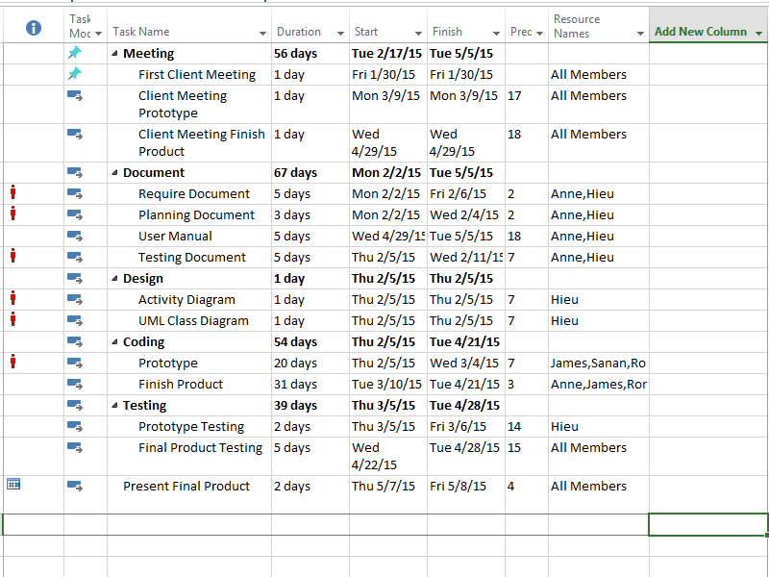
Deviations – Plan
“Requirements well established” (or so we thought)
No unit testing/testing software
Did not follow task list timeline (wasn’t well planned in first place)

Slide 18
Hypothetical – Anne
What if we had more time?
Improve processing time, design of interface (change color scheme of form, more feedback from tool), ensure customer satisfaction
What if we could start over?
Start coding sooner
Plan/work on more defined, divided goals/milestones
Interact more with customer
What I learned
Image processing/manipulation through C#
Software Engineering Documentation
Team work/brainstorming

Slide 19
Hypothetical – Sanan
What if we had more time?
Test the project more thoroughly
What if we could start over?
Begin testing earlier
What I learned
How teams work in real world projects
Documentation & testing

Slide 20
Hypothetical - Romando
What if we had more time?
Perform more testing
What if we could start over?
Communicate more with clients
Have necessary resources
What I learned
Link components together using COM
Importance of documentation/designs
Teamwork

Slide 21
Hypothetical – James
What if we had more time?
Further optimization of process time
What if we could start over?
Collaborate with customer more often
Consider an Agile development approach
What I learned
Proper software development process
Practical use of multithreading

Slide 22
Hypothetical – Hieu
What if we had more time?
Improve software performance time
What if we could start over?
Better communication with client
What I learned
Improved documentation
Time management skills

Slide 23
Conclusion
Project is overall success
Almost every goal achieved
Accurate results
Highly automated (Little user interaction)
Structured development process

Slide 24
References
"The Leidenfrost Effect: How to Make a Liquid Levitate." YouTube. YouTube, n.d. Web. 10 Mar. 2015.
Questions?

